Slide 1
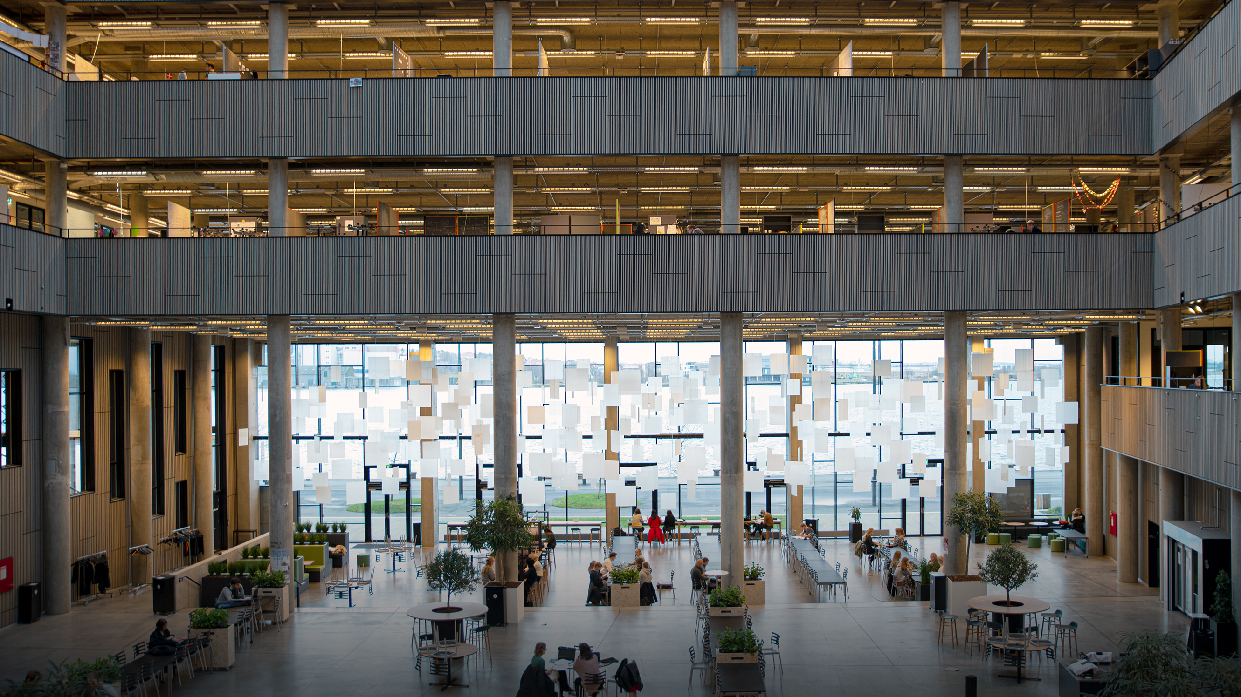

MUSICAL BIOFEEDBACK FOR STROKE REHABILITATION
PRITHVI RAVI KANTAN, 11.2.21

Slide 2
WHO AM I?
B.E. in Electronics and Telecommunications Engineering from Mumbai University (2013)
M. Sc. in Sound and Music Computing from AAU-CPH (2020)
Work experience in IT, sound engineering, music production and audio programming.
PhD student at AAU-CPH at the Department of Architecture, Design and Media Technology
(1.1.2021 - present)
DEPARTMENT OF ARCHITECTURE, DESIGN AND MEDIA TECHNOLOGY

Slide 3
MY RESEARCH – MUSICAL BIOFEEDBACK
Focus: Post-stroke gait and balance rehabilitation.
Essence:
Providing real-time kinematic feedback in the form of manipulations to a musical auditory stimulus.
Creating movement-music interactions tailored to specific training exercises (e.g. reaching, static upright sitting).
How long have I worked on this?
Two years worth of M.Sc. semester projects, five months of research assistantship.
Collaboration with Assoc. Prof. Erika Spaich since Aug 2019.
What has it involved thus far?
Creation of hardware/software prototypes in iterative cycles of development (six to date).
Evaluation through expert interviews with clinicians: physiotherapists and music therapists.
Evaluation through preliminary trials, interviews with sub-acute patients (courtesy Neuroenhed Nord)
System benchmarking
DEPARTMENT OF ARCHITECTURE, DESIGN AND MEDIA TECHNOLOGY

Slide 4
WHY MUSIC?
Stroke patients experience: (Boukakida et al., 2015; Niam et al., 1999)
Hemiparesis - Muscle weakness and spasticity
Impaired somatosensory input, distorted proprioception
Impaired muscle, joint coordination
Rehabilitation goals: (Schaechter, 2003)
Regain lost strength
Re-learn movements to leverage neuroplasticity
DEPARTMENT OF ARCHITECTURE, DESIGN AND MEDIA TECHNOLOGY

Slide 5
WHY MUSIC?
Stroke patients experience: (Boukakida et al., 2015; Niam et al., 1999)
Hemiparesis - Muscle weakness and spasticity
Impaired somatosensory input, distorted proprioception
Impaired muscle, joint coordination
Rehabilitation goals: (Schaechter, 2003)
Regain lost
Re-learn movements to leverage neuroplasticity
Repetitive Training - adherence is key to recovery (Miller et al., 2017)
Painful
Monotonous
Difficult
Time-consuming
FEEDBACK IS CRITICAL
(Maes et al., 2016)
DEPARTMENT OF ARCHITECTURE, DESIGN AND MEDIA TECHNOLOGY

Slide 6
WHY MUSIC?
Movements share structural characteristics with musical signals (Thaut et al., 2016) :
Periodicity (Meter in music)
Temporal Organization (Rhythm)
Repetitive Contours (Melody/Harmony Contours)
Universally understandable ‘grammar’ and ‘syntax’ (Vickers et al., 2006).
Universal socio-cultural appeal and inherent ability to motivate, monitor and modify movement (Maes et al., 2016)
Ability to reduce perceived exertion, pain and improve mood during exercise (Fritz et al., 2013, 2018)
Temporal resolution of auditory modality (Hermann et al., 2011)
(Maes et al., 2016)
DEPARTMENT OF ARCHITECTURE, DESIGN AND MEDIA TECHNOLOGY

Slide 7
BUT HOW TO UNLOCK THIS POTENTIAL? Key Consideration is Mapping – syntax that relates movement to sound (Dyer, 2017)
Is the goal to:
Simply increase motivation during rehabilitation using music?
Improve task performance during training?
Enhance motor learning for long-term retention of gains?
What movement parameters should manipulate the musical signal?
Knowledge of Performance or Knowledge of Result?
A.k.a. Movement Effector Kinematics or Performance Metrics? (Dyer et al., 2017)
How should the musical signal be manipulated?
Manipulation of pre-recorded song or real-time music synthesis?
Feedback based on movement itself or movement error? (Rosati et al., 2012; Sigrist et al., 2013)
What characteristic of music is manipulated by what aspect of movement? E.g. walking cadence mapped to music tempo (Moens et al., 2014)
DEPARTMENT OF ARCHITECTURE, DESIGN AND MEDIA TECHNOLOGY

Slide 8
CHALLENGES
Feedback needs to be (Vos et al., 2018):
Meaningful, understandable
Easily perceptible
Timely
Not cognitively overwhelming
Customizable to suit the needs of individuals with varied ability (Lesaffre, 2018)
Potentially infinite mappings to evaluate – how to narrow them down?
Synthesized musical biofeedback can sound poor in comparison to ‘real’ music (Yu, 2018).
COVID-19 restrictions – how to proceed?
DEPARTMENT OF ARCHITECTURE, DESIGN AND MEDIA TECHNOLOGY

Slide 9
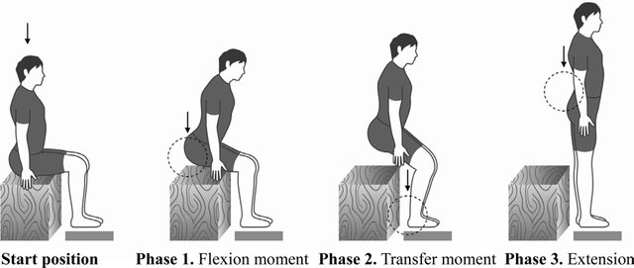
SIT-TO-STAND TRANSITION
Image courtesy of Kim et al., 2017
DEPARTMENT OF ARCHITECTURE, DESIGN AND MEDIA TECHNOLOGY

Slide 10
SIT-TO-STAND TRAINING SYSTEM – AN EXAMPLE (work-in-progress)
Common in stroke rehabilitation, important activity of daily life.
Requires hip, knee coordination (Boukakida et al., 2015), impaired in stroke patients.
Can be captured by measuring anteroposterior angular orientation of three body segments
Trunk
Thigh
Shank
Mediolateral trunk tilt due to hemiparesis should also be captured and fed back.
DEPARTMENT OF ARCHITECTURE, DESIGN AND MEDIA TECHNOLOGY

Slide 11
TOPOLOGY OF OUR SYSTEM
Distributed Architecture: Sensing, processing and feedback actuators at different locations.
9 Axis wireless IMU-based measurement.
Windows application – interface for real-time configuration of measurement and feedback.
Feedback actuator is either headphones or loudspeakers.
Built using open-source tools (JUCE using C++, FAUST for audio).
DEPARTMENT OF ARCHITECTURE, DESIGN AND MEDIA TECHNOLOGY

Slide 12
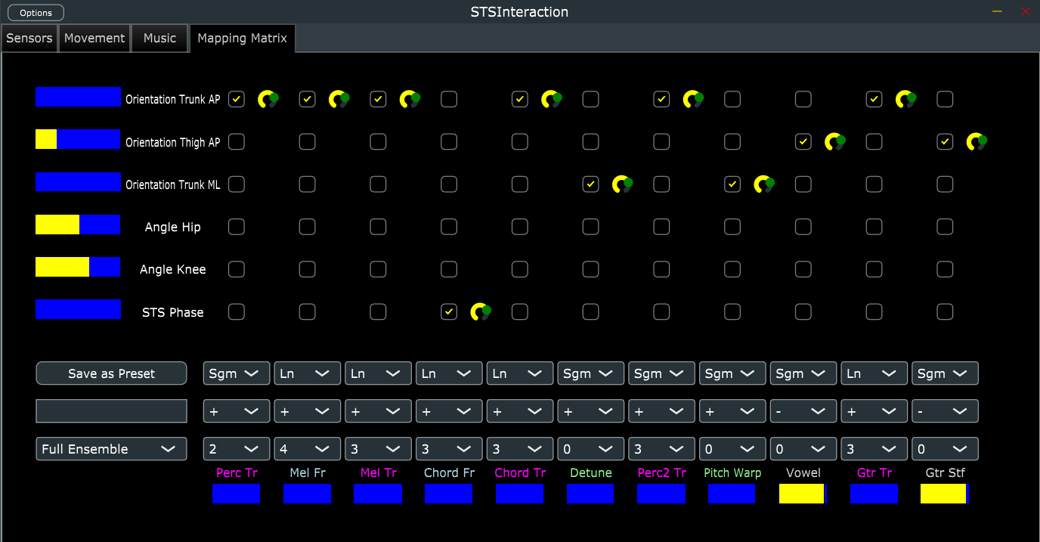
DEPARTMENT OF ARCHITECTURE, DESIGN AND MEDIA TECHNOLOGY

Slide 13
VIDEO DEMO
DEPARTMENT OF ARCHITECTURE, DESIGN AND MEDIA TECHNOLOGY

Slide 14
RESEARCH METHODS (TENTATIVE)
Listening Tests - Intermodal Discrimination (Vinken et al., 2013)
Iterative workshops with clinicians and patients to fine-tune feedback mappings and stimulus choices.
Randomized-controlled effect studies with patients, including short-term retention.
DEPARTMENT OF ARCHITECTURE, DESIGN AND MEDIA TECHNOLOGY

Slide 15

QUESTIONS?
DEPARTMENT OF ARCHITECTURE, DESIGN AND MEDIA TECHNOLOGY

